Slide 1
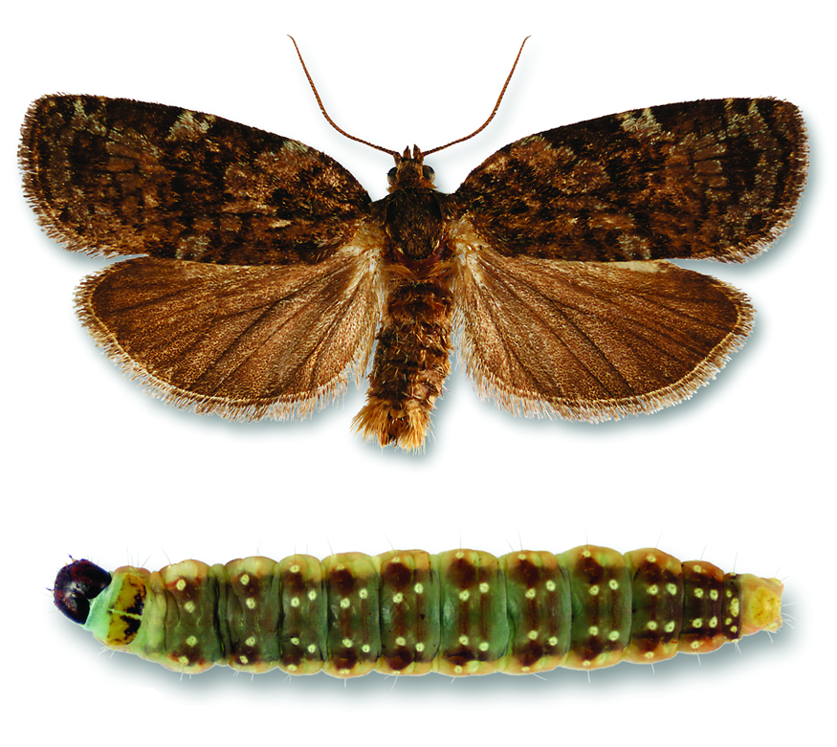
Page 01
Insect Outbreak:
Searching for Patterns in
Heterogeneous Environments
Summer Research Programme 2025, IMSc, Chennai
Presented by Ayaan Dutt
BSc Physics, Ashoka University

Slide 2
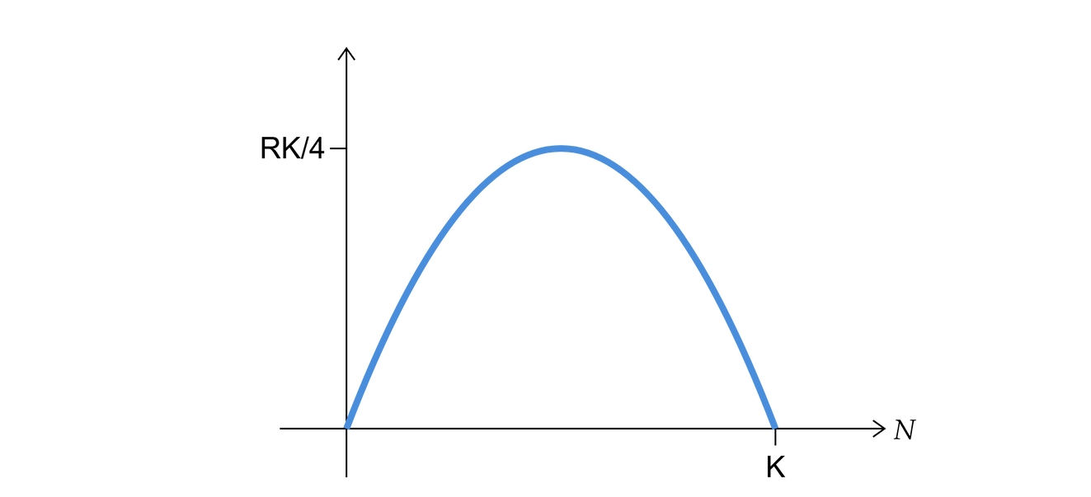
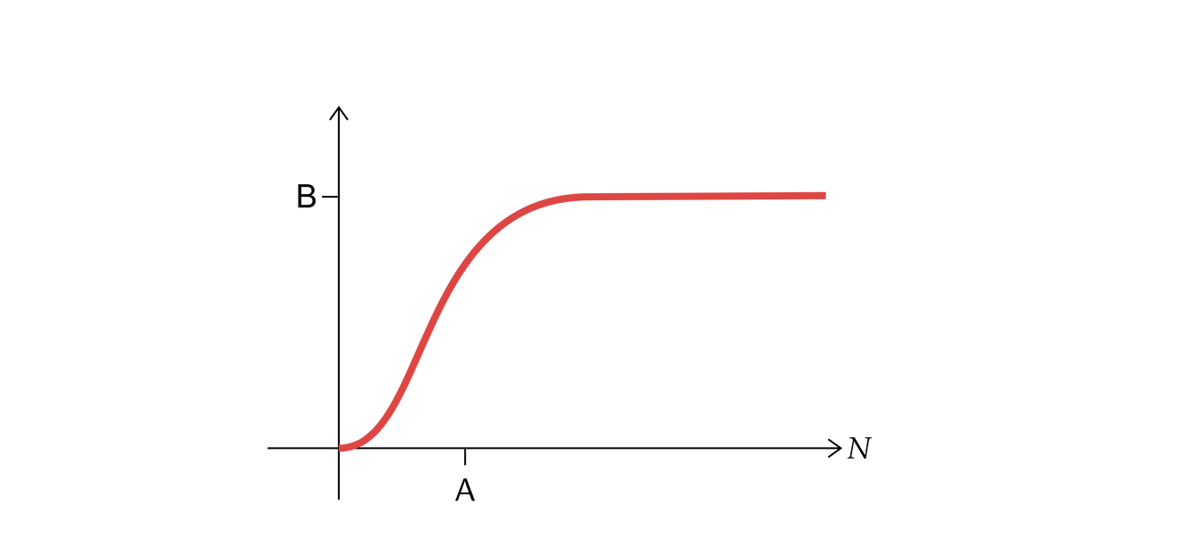
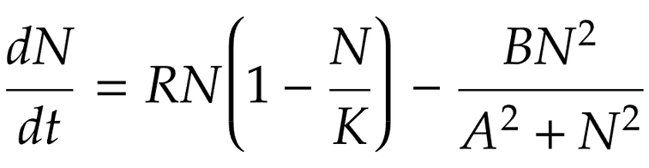
Explaining an Outbreak
Page 02
Can an insect outbreak be thought of as a phase transition?
Gradual change of parameters over time (i.e. growth of the forest)
Sudden jump from low (i.e. refuge) population to high (i.e. outbreak) population.
Ludwig et al. (1978) proposed a simple population dynamics model to explain this phenomenon in Canadian spruce budworm. This model assumed spatially homogeneous parameters.
Growth
Predation

Slide 3
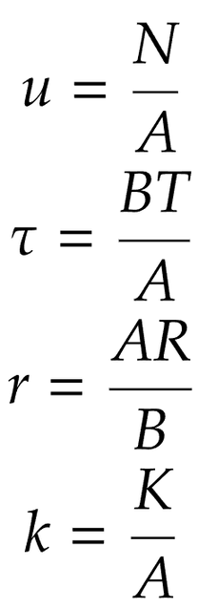
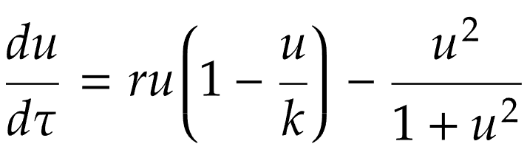
Dimensionless Formulation
Page 03
To simplify our analysis, we can reduce the number of parameters by non-dimensionalizing the equation:
Rescaled Population
Rescaled Time
Where
Rescaled Growth Rate
Rescaled Carrying Capacity

Slide 4
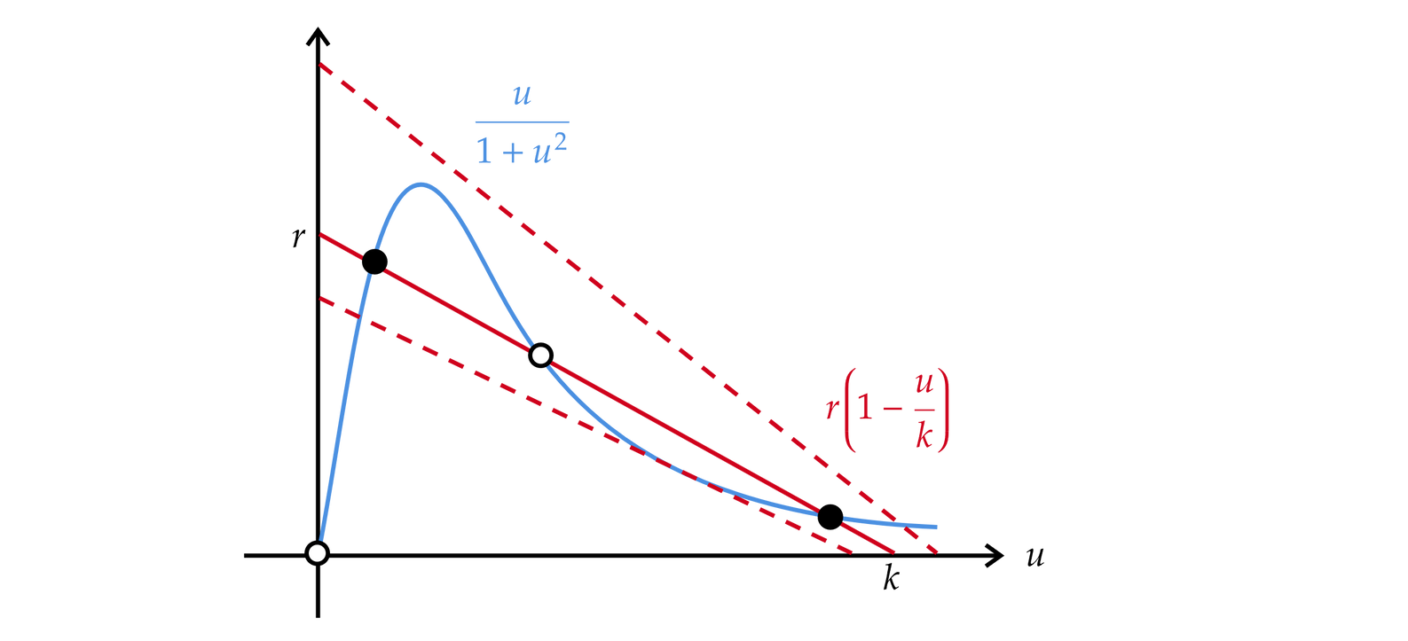
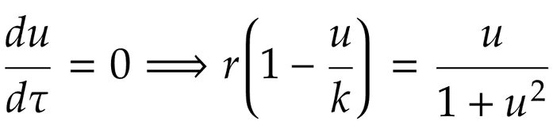
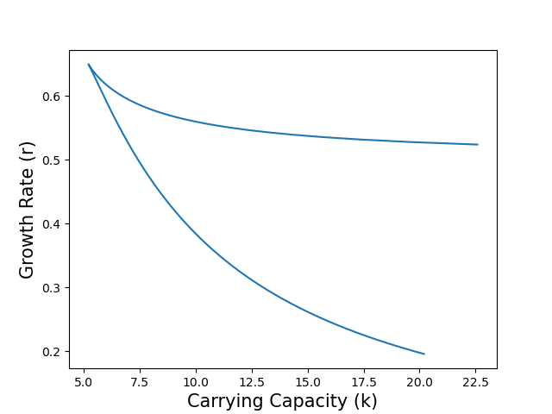
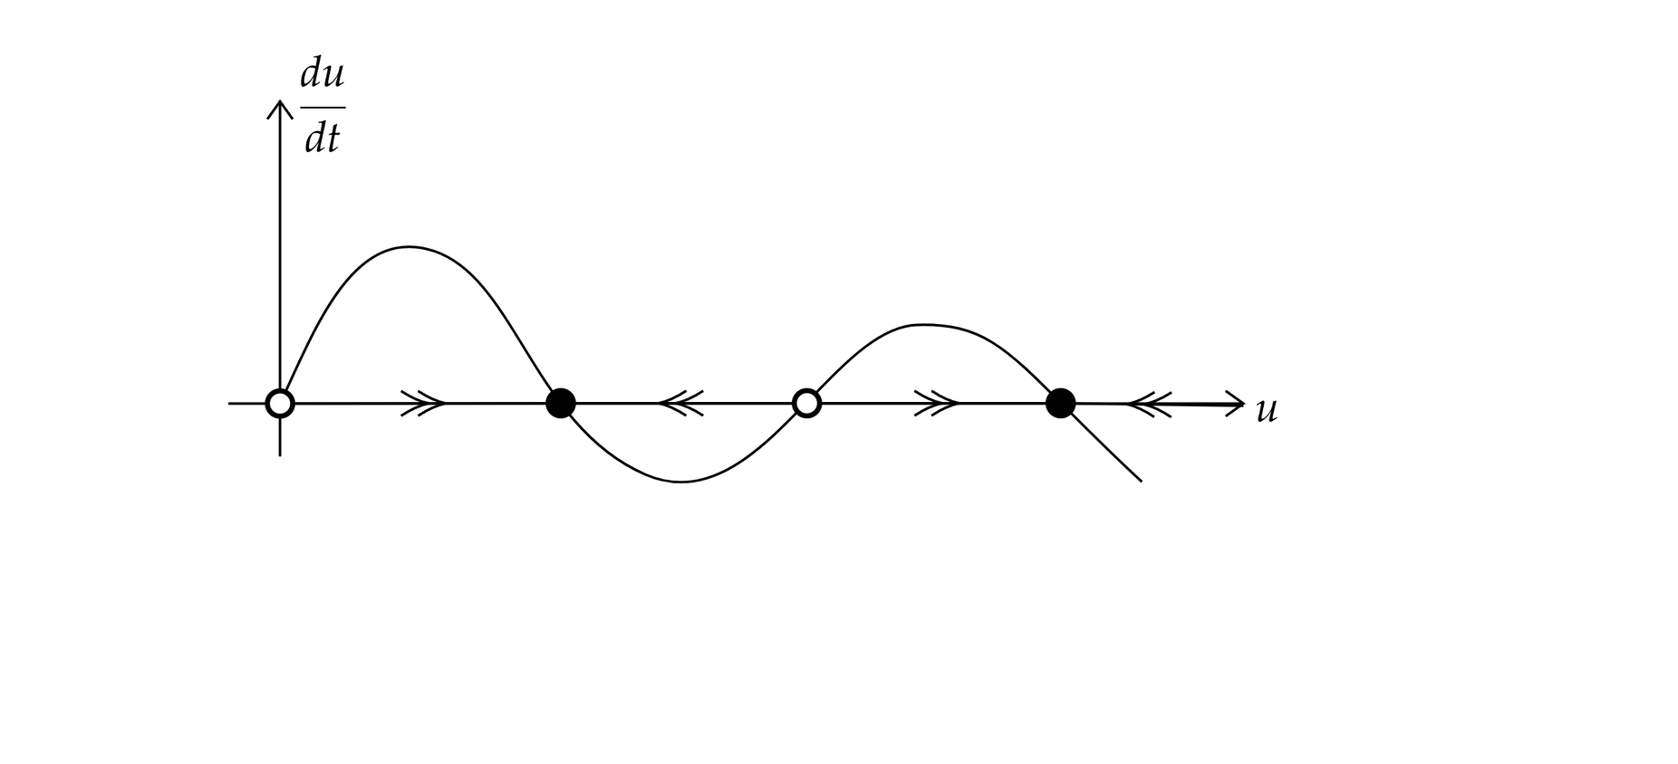
Fixed Point Analysis
Page 04
For long-term behaviour, we look for the fixed points (i.e. du/dt = 0). We find that we can get upto 3 fixed points, depending on the values of r and k.
Outbreak
Bistable
Refuge

Slide 5
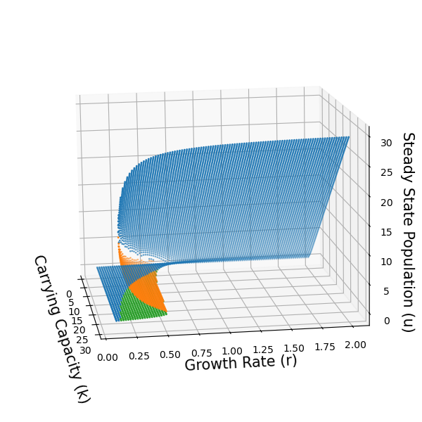
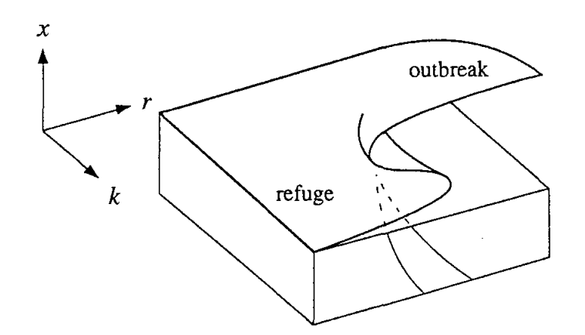
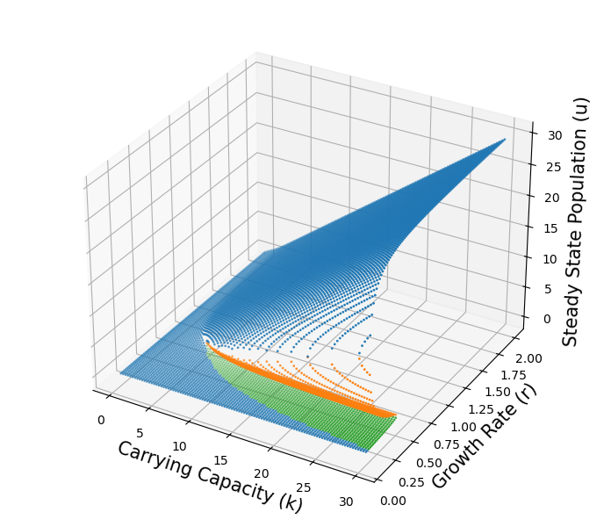
Cusp Catastrophe Curve
Page 05

Slide 6

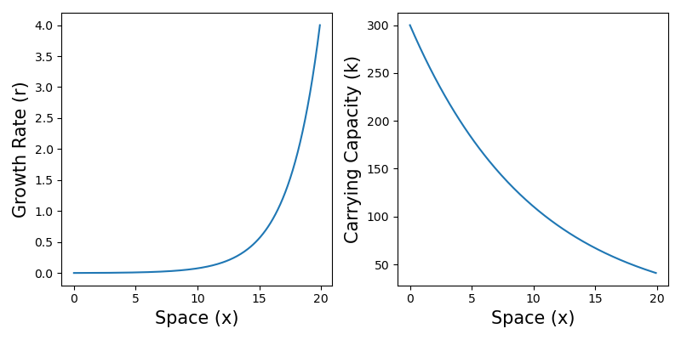
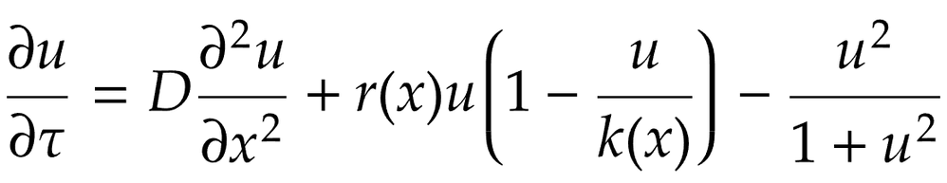
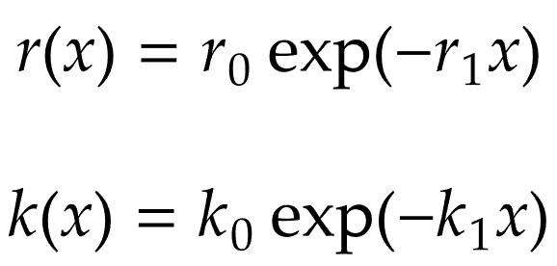
Introducing
Page 06
Natural environments are rarely homogenous. Heterogeneities might exist due to random events or external forces.
Spatial gradients in resources might influence how populations grow and even lead to patterns.
Sunlight gradient at the surface of the ocean
Nutrient gradient around a food source
Chemical gradient inside a developing embryo
Diffusion
Reaction

Slide 7
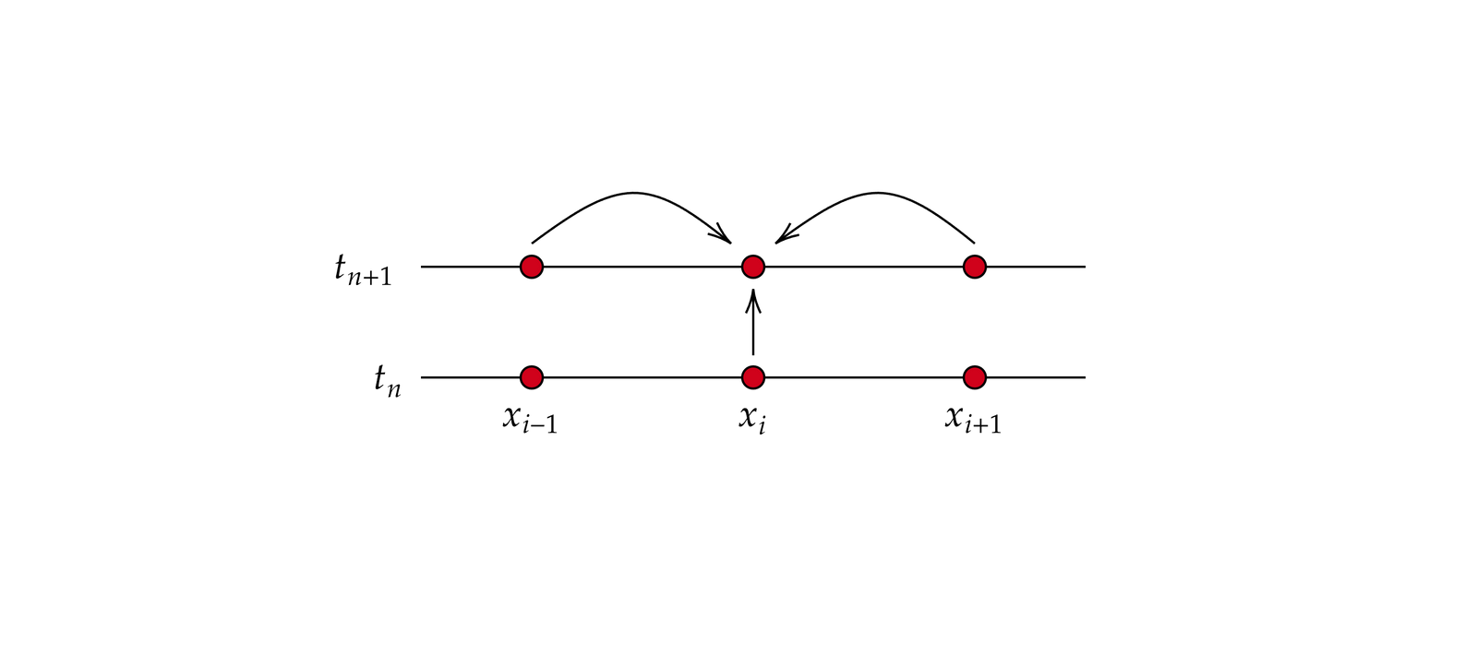
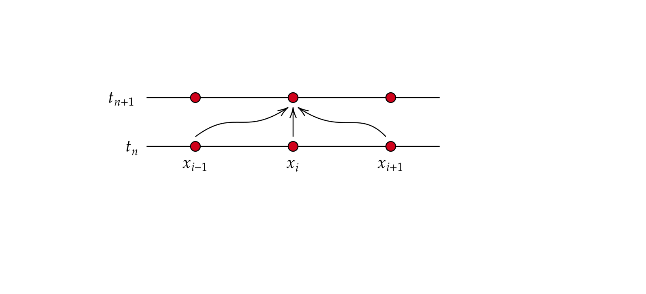
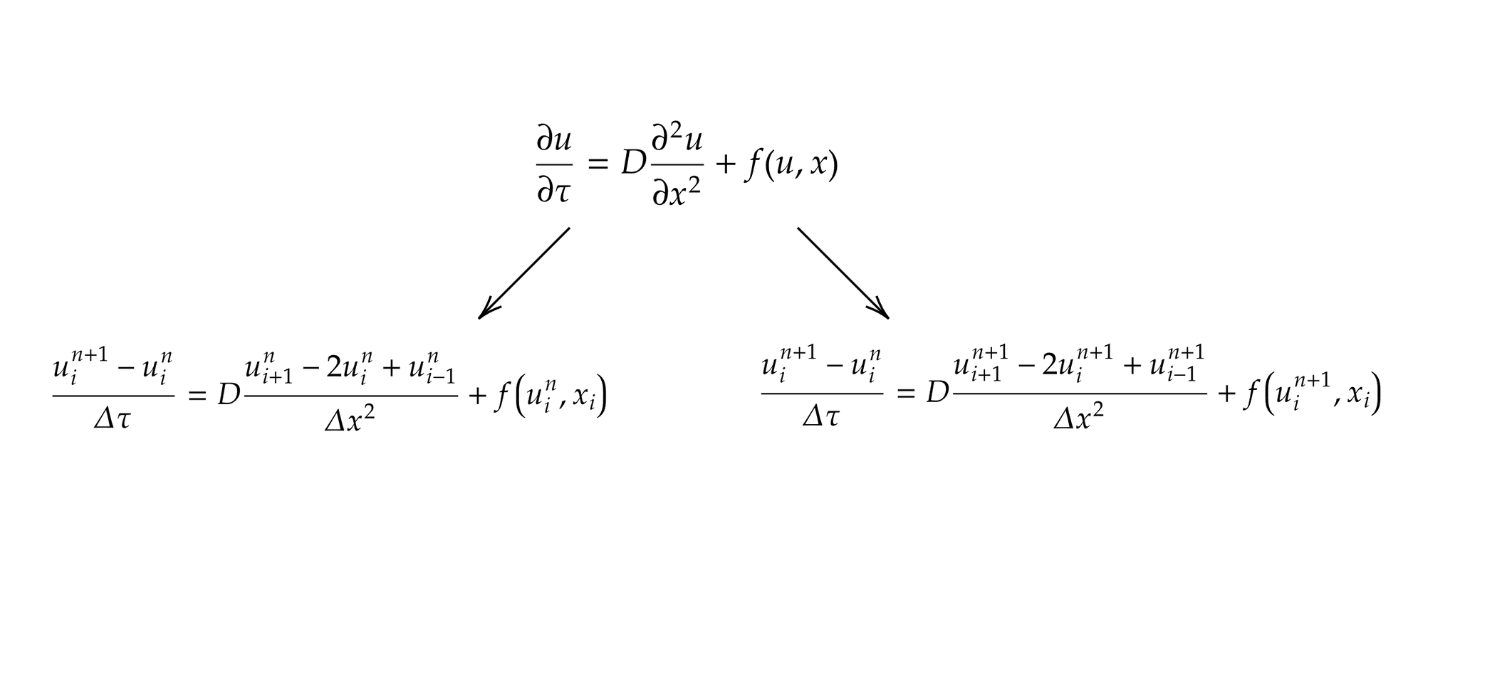
Numerically Solving RDEs
Page 07
Explicit Scheme
Implicit Scheme
Pros:
Easy to implement
Faster to compute
Cons:
Has limited stability
Boundary effects lag by 1 step
Pros:
Much more stable than explicit
No lag at boundary
Cons:
Difficult to implement (especially for nonlinear equations)
Takes longer to compute

Slide 8
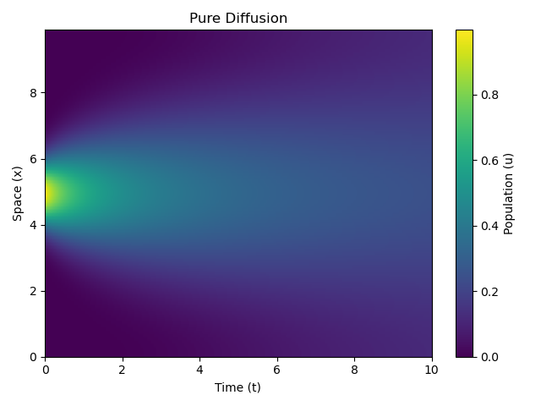
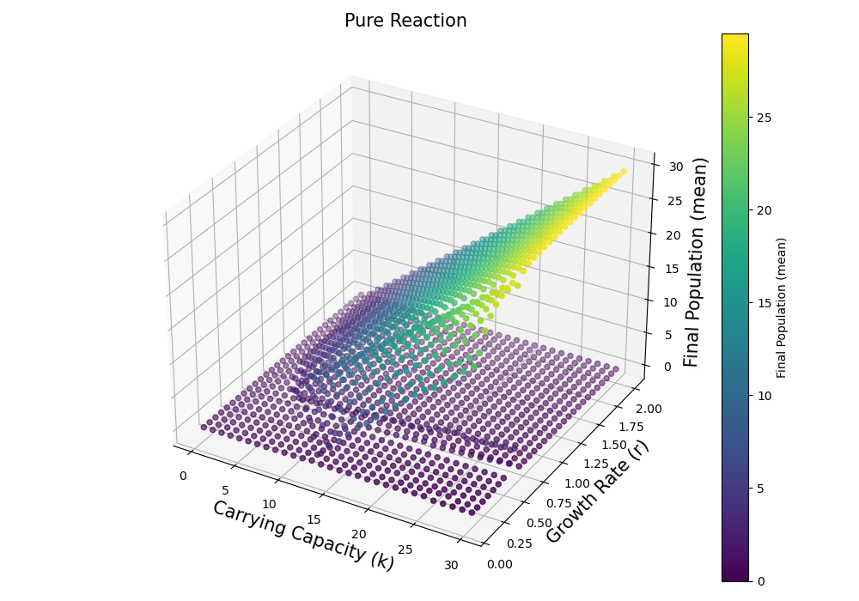
Verifying the Method
Page 08

Slide 9
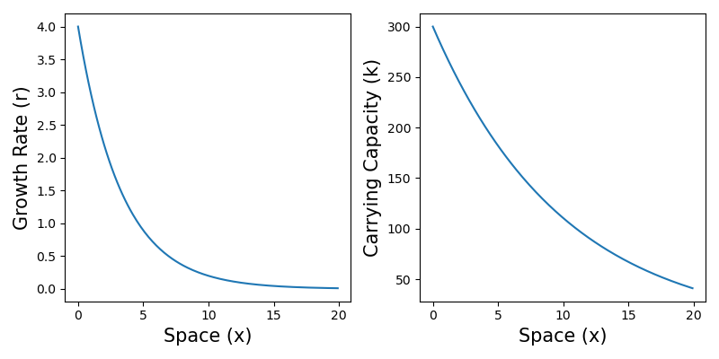
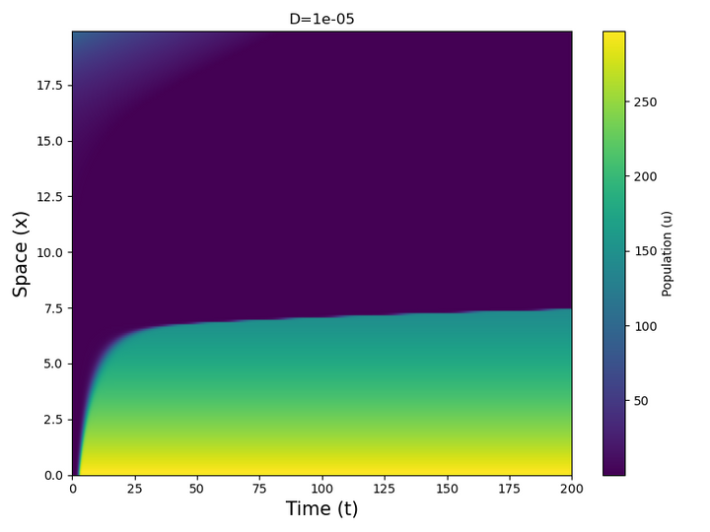
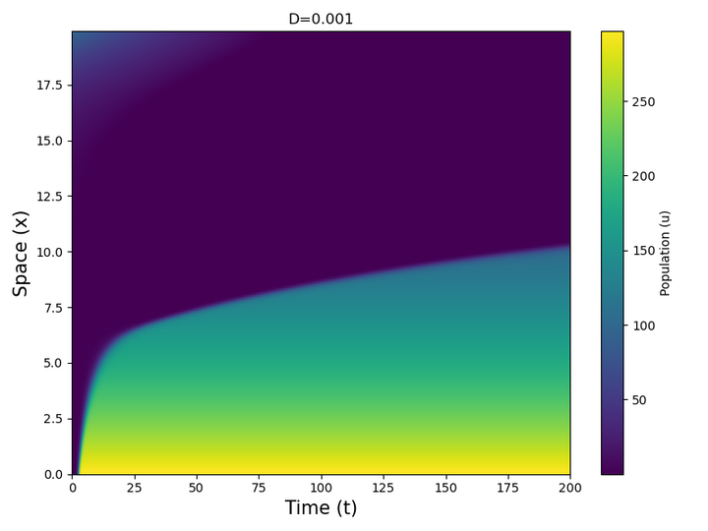
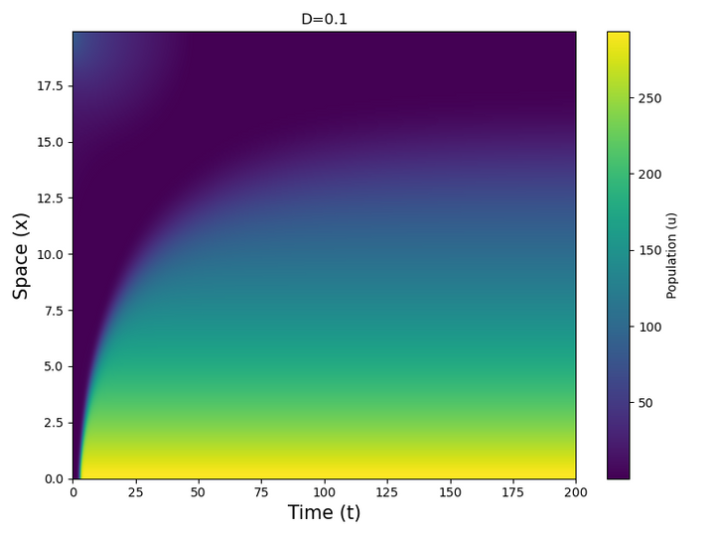
Parallel Gradients
Page 09
As the diffusion is strengthened, the population shows a travelling wave in space which asymptotically appears to approximate the carrying capacity gradient.
The speed of the wave is not constant, but it slows down as it approaches the boundary.

Slide 10
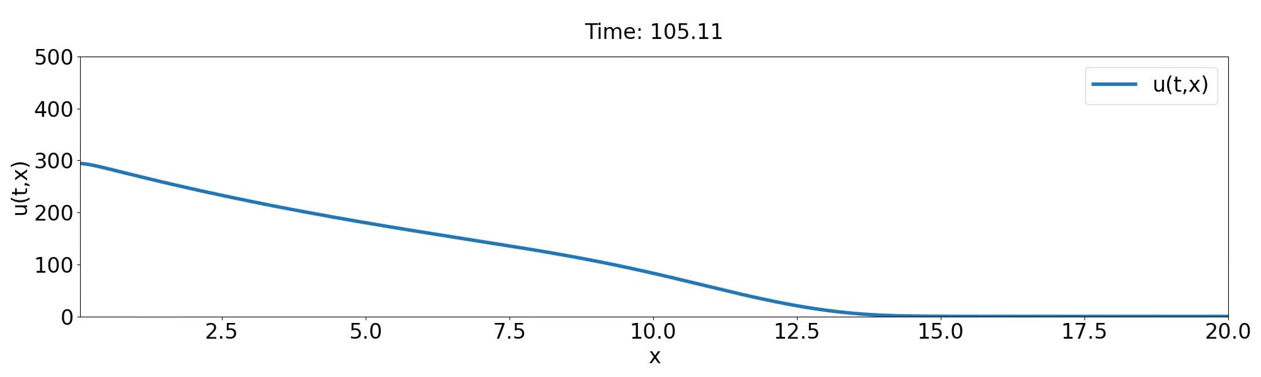
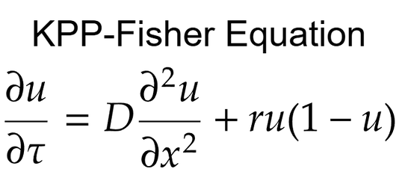
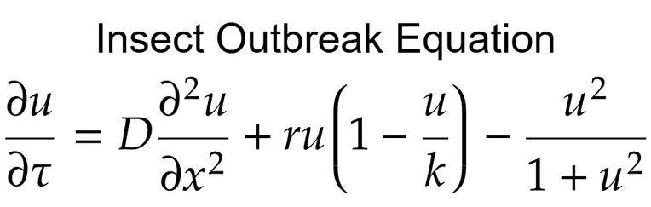
Page 10
This wave-like behavior appears to be similar to the KPP-Fisher equation, which is also a RDE with a logistic growth reaction term, but no predation term. This is likely because the predation term tends towards a constant at sufficiently large populations, essentially reducing our equation to a rescaled and shifted KPP-Fisher equation.

Slide 11
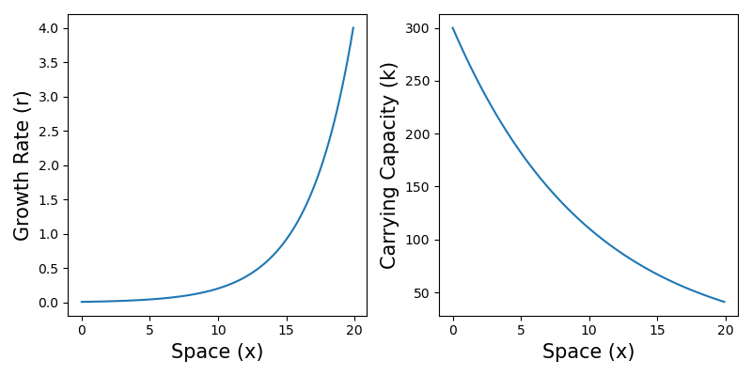
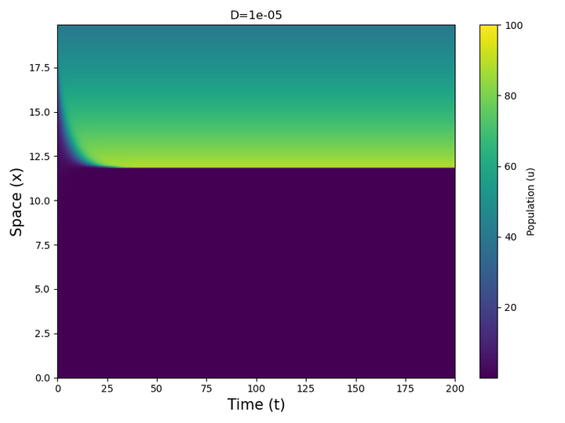
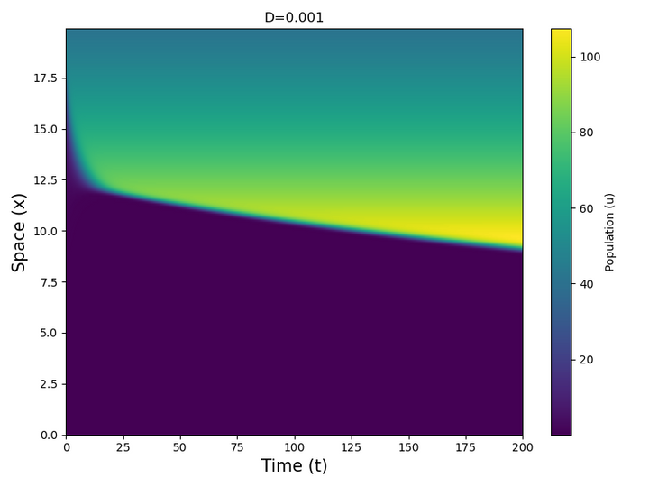
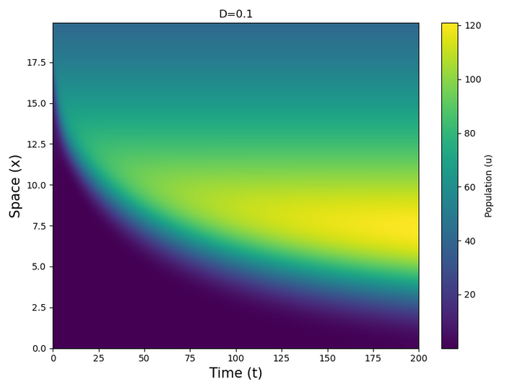
Anti-Parallel Gradients
Page 11
The population seems to tend towards the carrying capacity gradient again, but this time it begins from the end and the wave is led by a peak rather than a dip.
This wave also slows down as it approaches the boundary.

Slide 12
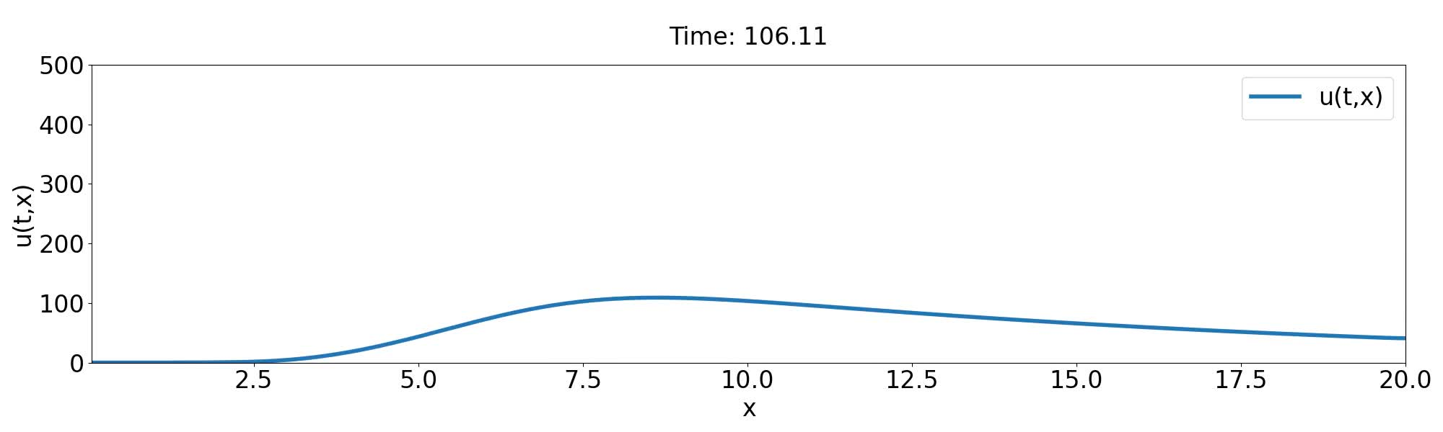
Page 12

Slide 13
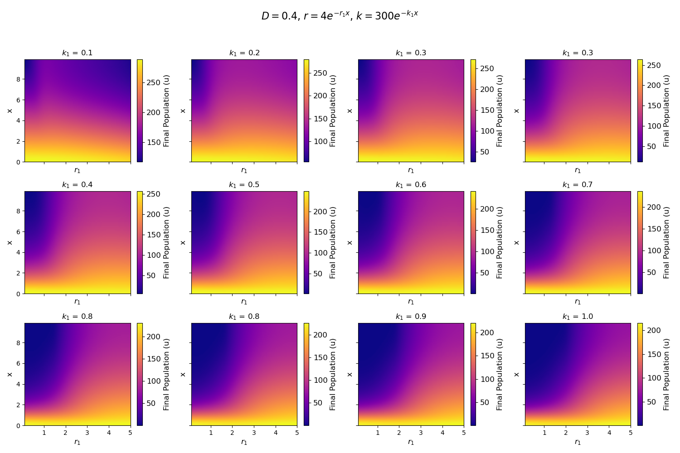
Parameter Dependence
Page 13
There doesn’t seem to be much qualitative change in behaviour for different gradients.
Changing the growth rate gradient affects the speed of the waves.
Changing the carrying capacity affects the asymptotic spatial distribution.

Slide 14
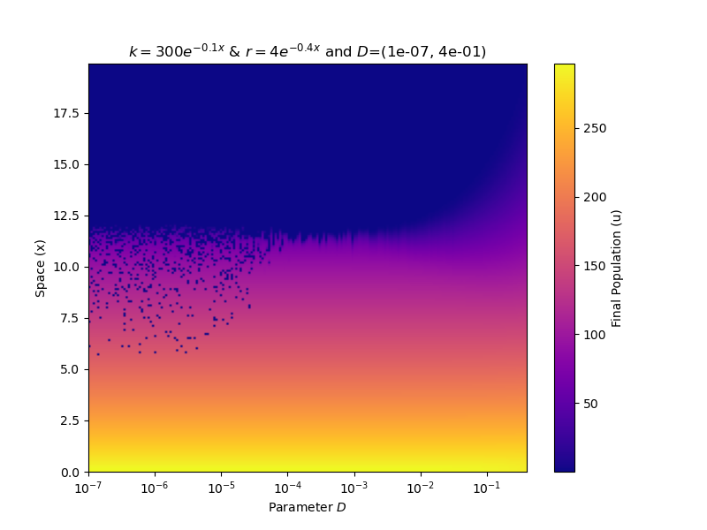
Work in Progress
Page 14
I am currently exploring several directions with this project:
Effect of Diffusion and Collapse of Bistability
01
As diffusion is increased, the transition from refuge to outbreak appears to smoothen, effectively eliminating the phase-transition behaviour.

Slide 15
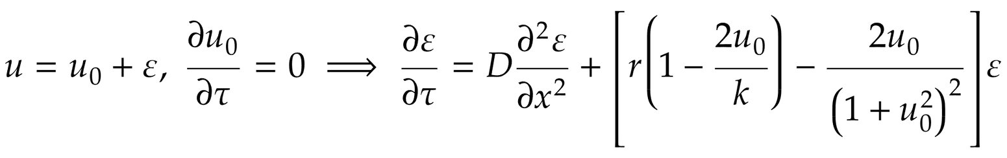
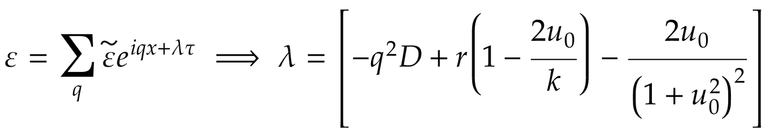
Page 15
Linear Stability Analysis
02
Considering a small perturbation close to the stable fixed points u0, we can analytically search for instabilities in the RDE:
Assuming a Fourier series solution:

Slide 16
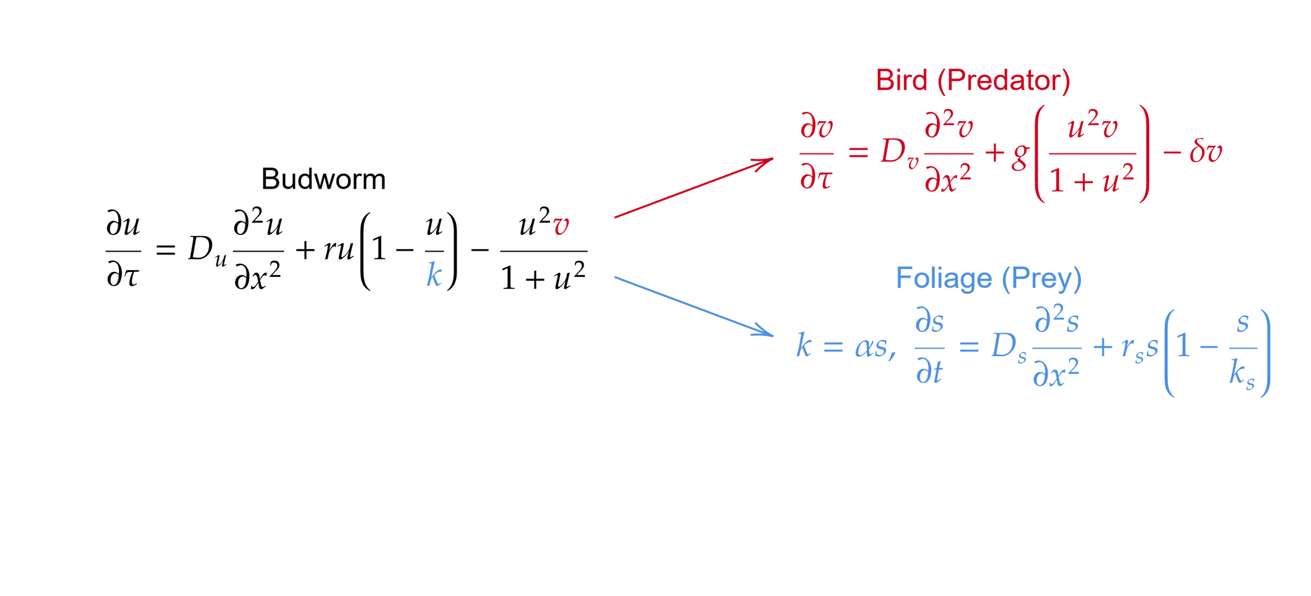
Page 16
Adding Variables (Turing Patterns)
03
Constructing a 2-variable reaction-diffusion system to look for spatial patterns like spots, stripes and waves.
Spatial gradients can often allow for multiple coexisting patterns in space, and can be used to explain phenomena such as cell differentiation.

Slide 17
Acknowledgements
Page 17
Firstly, I thank Prof. Sitabhra Sinha for his inputs and ideas that gave direction to this project. I also thank Shakti, Harish and Akshay for their helpful discussions and suggestions. Finally, I thank my peers - Ayush, Anahita, Neha, Sharmada, Anarghya, Shristi, Rwitacheta and Anagha - for their constant support and encouragement.
References
Ludwig, D., Jones, D. D., & Holling, C. S. (1978). Qualitative analysis of insect outbreak systems: the spruce budworm and forest. Journal of Animal Ecology, 47(1), 315. https://doi.org/10.2307/3939
Ludwig, D., Aronson, D. G., & Weinberger, H. F. (1979). Spatial patterning of the spruce budworm. Journal of Mathematical Biology, 8(3), 217–258. https://doi.org/10.1007/bf00276310
Barba, L. A., Cooper, C. D., & Forsyth, G. F. (2014). Finite difference method for (partial) differential equations [Jupyter notebook]. GitHub. https://github.com/TuxRiders/numerical-computing-intro
Roques, L. (2024). Readi2solve: An Online Python Toolbox for Solving Reaction-Diffusion Problems. https://hal.inrae.fr/hal-04728969v1

